Slide 1
Memory test game

Slide 2
Introduction
Group Members
Minh Nhat Bui
James Hoff
Ahmad Shabaneh

Slide 3
Program summary
This is a memory test game that displays a number of patterns, which allows the user to trace or follow the pattern accurately.
If the user traced or followed these patterns correctly, the game level increases.
As the level increase, the number of boxes to be trace or follow increase, and the timing moves fast.

Slide 4
Game Rule
1) Click on the start bottom the begin the game.
2) Carefully observe the box pattern on the screen.
3)Once the pattern ends, follow the pattern by clicking the right boxes.
Click right pattern, move to next level
Click incorrect pattern, start the game over.

Slide 5
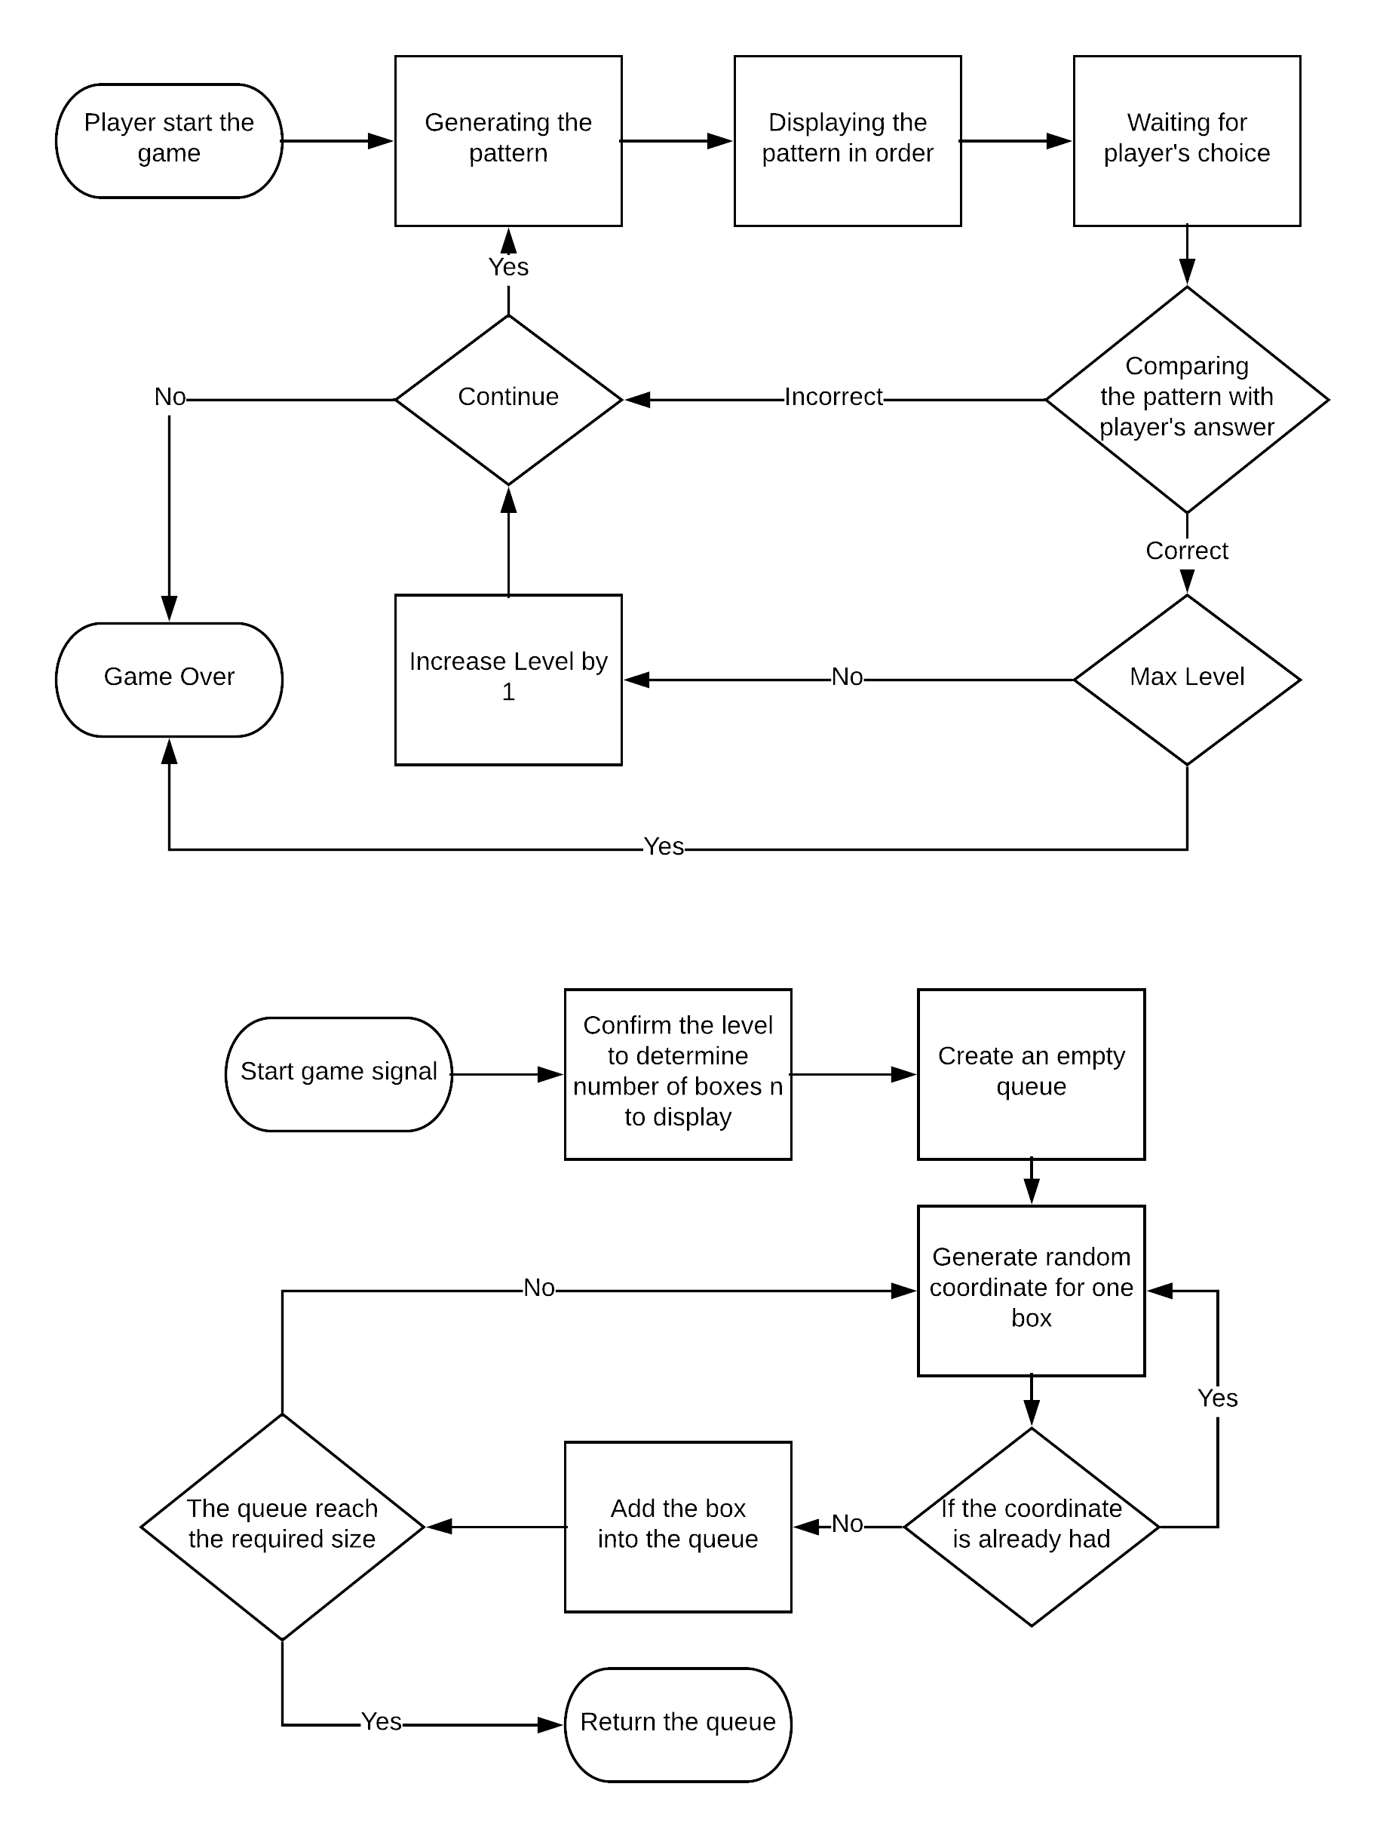
Flow Diagram - General

Slide 6
Flow Diagram - Generating

Slide 7
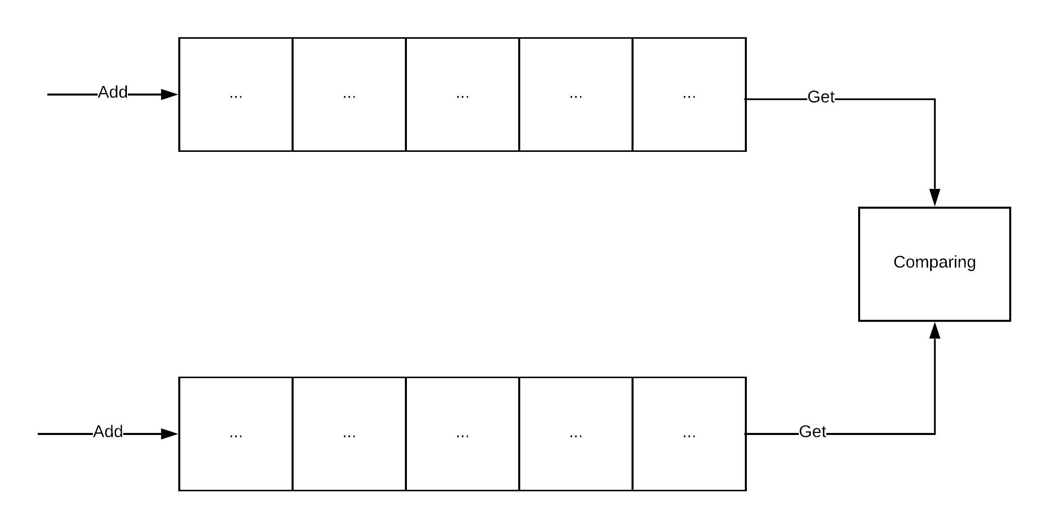
Flow Diagram - Comparing

Slide 8
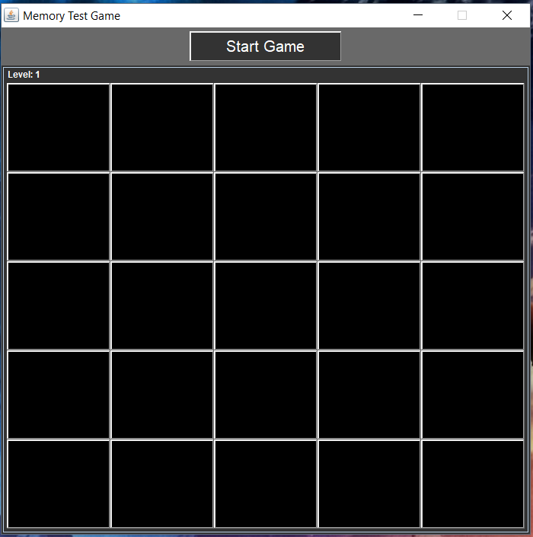
Demonstration

